Slide 1
Mitosis/Meiosis Assessment Name _________________
The smallest structural and functional unit of an organism is a/an __________.
A. atom
B. cell
C. chromosome
D. element
Germ cells are found in the ____________.
A. heart
B. lungs
C. muscles
D. ovaries
These structures become tightly packed during cell division. They contain DNA.
A. Centromeres
B. Centrioles
C. Chromosomes
D. Spindle Fibers
The stage in mitosis in which chromosomes replicate themselves.
A. Anaphase
B. Metaphase
C. Interphase
D. Telophase
The stage in mitosis that results in two new daughter cells being formed.
A. Anaphase
B. Metaphase
C. Prophase
D. Telophase
The cell elongates and the chromosomes move toward the poles during this stage.
A. Anaphase
B. Metaphase
C. Prophase
D. Telophase
The chromosomes line up in the middle of the cell during this stage.
A. Anaphase
B. Metaphase
C. Prophase
D. Telophase

Slide 2
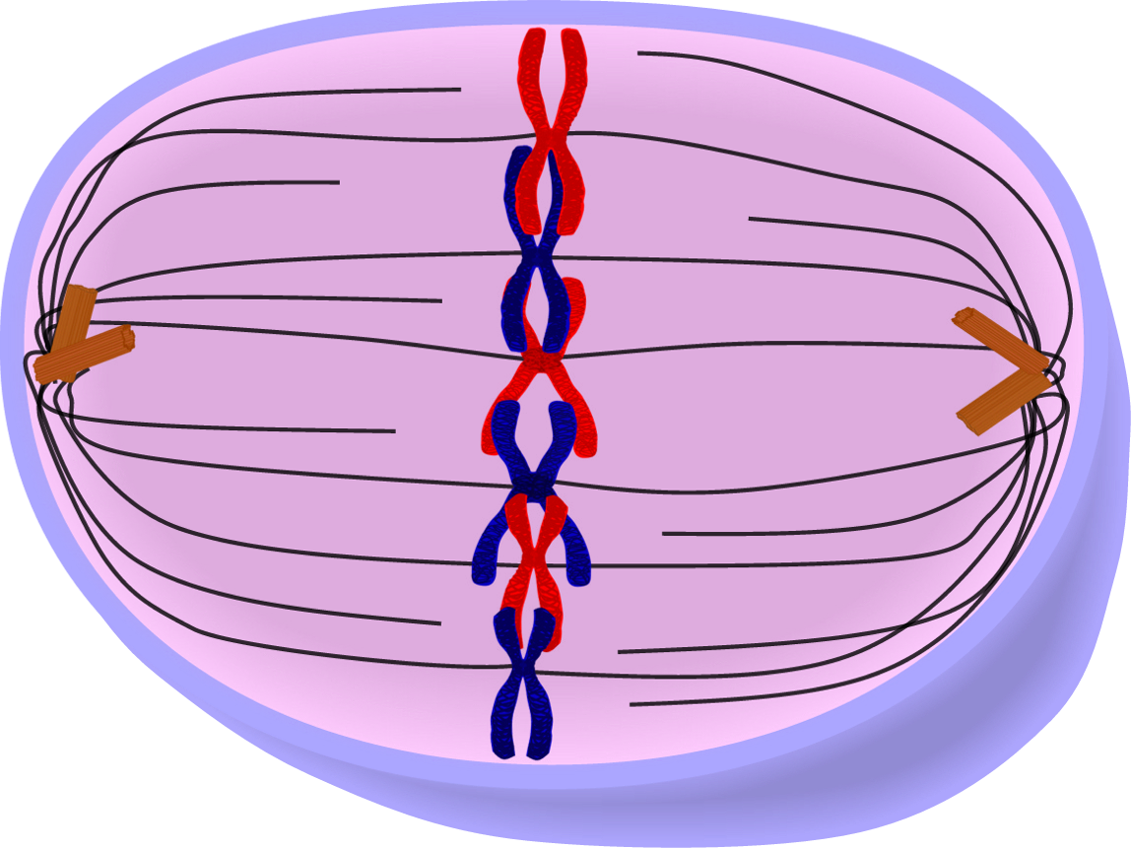
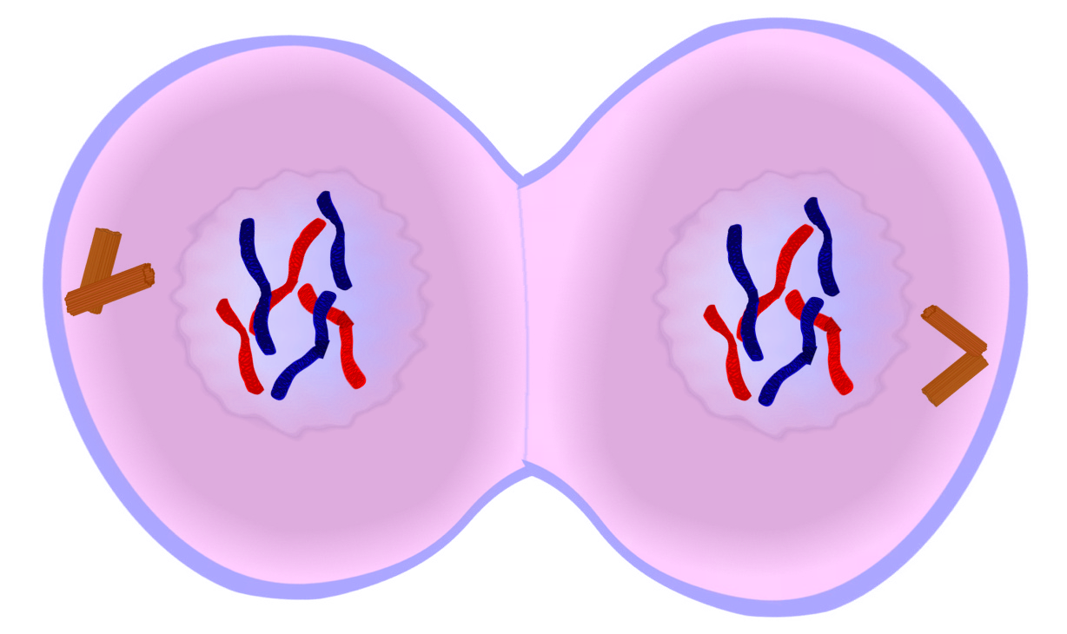
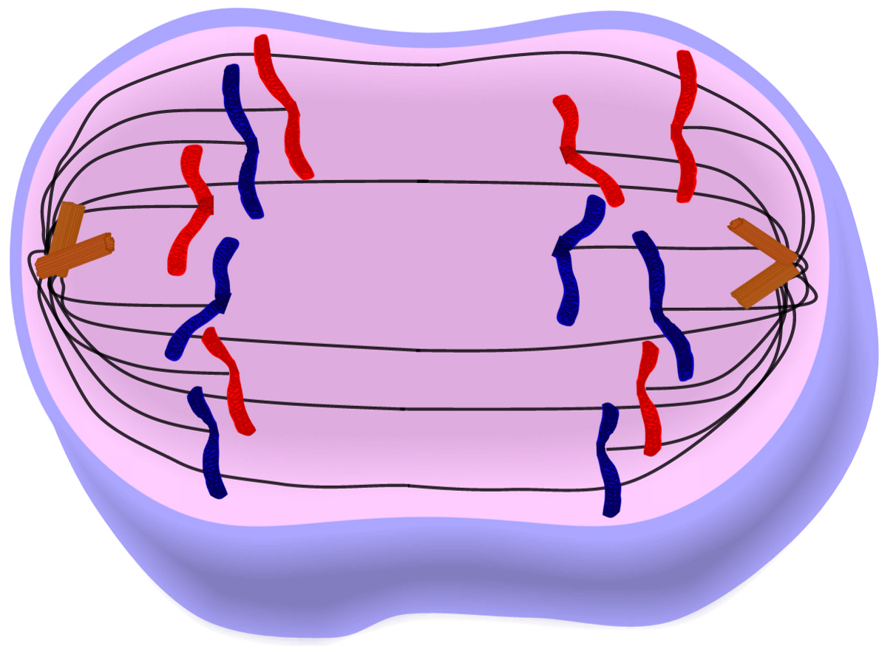
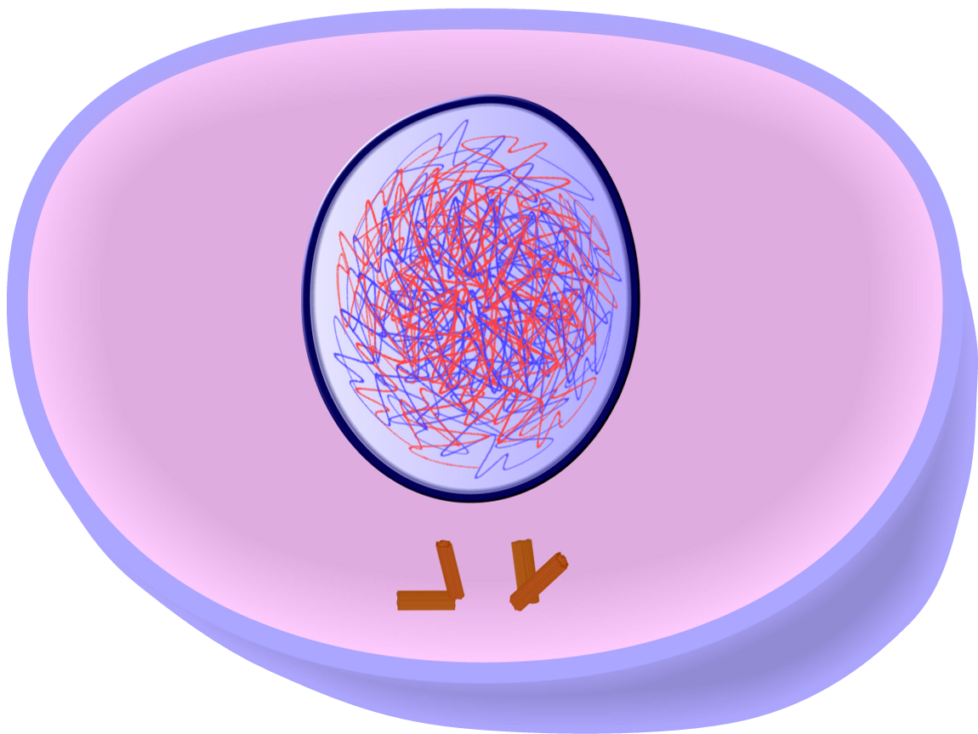
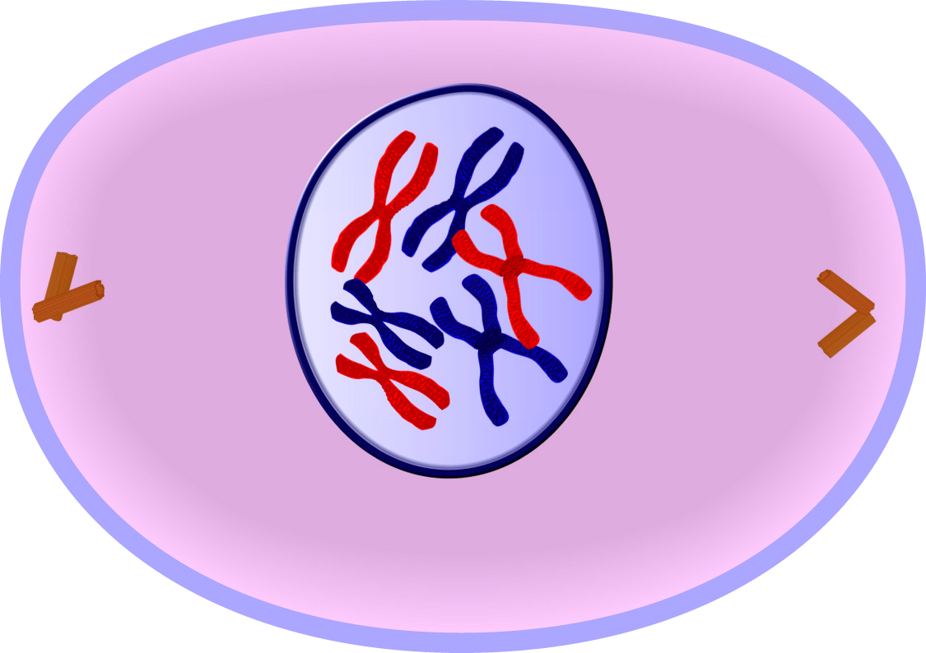
Mitosis/Meiosis Assessment Name _________________
8. The process where a pair of chromosomes pair up and exchange genetic material.
A. Crossing over
B. Gamete cells
C. Replication
D. Reproduction
9. In Meiosis II the cell division begins with how many daughter cells?
A. One
B. Two
C. Three
D. Four
10. Which is not true of Meiosis?
A. Meiosis starts with half the number of chromosomes as Mitosis.
B. The genetic offspring are exactly like the parent cell.
C. There are 23 chromosomes from each parent cell.
D. Meiosis goes through 2 stages of division, Meiosis I and II.
11.-15. Put the following in the correct order.
_____
_____
_____
_____
_____
A.
B.
C.
D.
E.

Slide 3
Mitosis/Meiosis Assessment Name _________________
16.-28. Compare and contrast mitosis and meiosis by completing this table. Use the word phrases below.
Mitosis | Same for Both | Meiosis
Creates 4 haploid cells Creates genetic diversity
Creates 2 diploid cells No genetic diversity
A type of cell division Identical to parent cell
One stage of division Different than parent cell
Two stages of division Replicates DNA
Creates new cells
Body cells divide
Sex cells divide

Slide 4
Mitosis/Meiosis Assessment Name _________________
KEY
The smallest structural and functional unit of an organism is a/an __________.
A. Atom
B. Cell
C. Chromosome
D. Element
Germ cells are found in the ____________
A. Heart
B. Lungs
C. Muscles
D. Ovaries
These structures become tightly packed during cell division. They contain DNA.
A. Centromere
B. Centriole
C. Chromosomes
D. Spindle Fibers
The stage in mitosis in which chromosomes replicate themselves.
A. Anaphase
B. Metaphase
C. Interphase
D. Telophase
The stage in mitosis that results in two new daughter cells being formed.
A. Anaphase
B. Metaphase
C. Prophase
D. Telophase
The cell elongates and the chromosomes move toward the poles.
A. Anaphase
B. Metaphase
C. Prophase
D. Telophase
The chromosomes line up in the middle of the cell.
A. Anaphase
B. Metaphase
C. Prophase
D. Telophase

Slide 5
Mitosis/Meiosis Assessment Name _________________
KEY
8. The process where a pair of chromosomes pair up and exchange genetic material.
A. Crossing over
B. Gamete cells
C. Replication
D. Reproduction
9. In Meiosis II the cell division begins with how many daughter cells?
A. One
B. Two
C. Three
D. Four
10. Which is not true of Meiosis?
A. Meiosis starts with half the number of chromosome as Mitosis.
B. The genetic offspring are exactly like the parent cell.
C. There are 23 chromosomes from each parent cell passed on to the offspring.
D. Meiosis goes through 2 stages of division, Meiosis I and II.
11.-15. Put the following in the correct order.
D
_____
_____
_____
_____
_____
A.
B.
E
A
C
C.
D.
B
E.

Slide 6
Mitosis/Meiosis Assessment Name _________________
KEY
Compare and contrast mitosis and meiosis by completing this table. Use the word phrases below.
Mitosis | Same for Both | Meiosis
Body cells divide | A type of cell division | Sex cell divide
One stage of division | Replicates DNA | Two stages of divisions (Meiosis l and ll)
Create diploid cells (2) | Creates new cells | Creates haploid cells (4)
Identical to parent cell |  | Different than parent cell
No genetic diversity |  | Creates genetic diversity
Creates 4 haploid cells Creates genetic diversity
Creates 2 diploid cells No genetic diversity
A type of cell division Identical to parent cell
One stage of division Different than parent cell
Two stages of division Replicates DNA
Creates new cells
Body cells divide
Sex cells divide

Slide 7
Mitosis/Meiosis Assessment Modified Name ________________
The smallest structural and functional unit of an organism is a/an __________.
A. Atom
B. Cell
C. Element
Germ cells are found in the ____________
A. Heart
B. Lungs
C. Ovaries
These structures become tightly packed during cell division. They contain DNA.
A. Centromere
B. Chromosomes
C. Spindle Fibers
The stage in mitosis in which chromosomes replicate themselves.
A. Anaphase
B. Metaphase
C. Interphase
D. Telophase
The stage in mitosis that results in two new daughter cells being formed.
A. Anaphase
B. Metaphase
C. Prophase
D. Telophase
The cell elongates and the chromosomes move toward the poles in this stage.
A. Anaphase
B. Metaphase
C. Prophase
D. Telophase
The chromosomes line up in the middle of the cell in this stage.
A. Anaphase
B. Metaphase
C. Prophase
D. Telophase

Slide 8
Mitosis/Meiosis Assessment Modified Name _________________
8. The process where a pair of chromosomes pair up and exchange genetic material.
A. Crossing over
B. Replication
C. Reproduction
9. In Meiosis II the cell division begins with how many daughter cells?
A. One
B. Two
C. Three
10. Which is not true of Meiosis?
A. Meiosis starts with half the number of chromosomes as Mitosis.
B. The genetic offspring are exactly like the parent cell.
C. Meiosis goes through 2 stages of division, Meiosis I and II.
11.-15. Put the following diagrams in the correct order.
_____
_____
_____
_____
_____
A.
B.
C.
D.
E.

Slide 9
Mitosis/Meiosis Assessment Modified Name _________________
16.-25. Compare and contrast mitosis and meiosis by completing this table. Use the word phrases below.
Mitosis | Same for Both | Meiosis
Creates 4 haploid cells Creates genetic diversity
Creates 2 diploid cells No genetic diversity
Creates new cells Identical to parent cell
One stage of division Different than parent cell
Two stages of division Replicates DNA

